Slide 1
Policy options for natural disaster risk management
Modeling the economics of adaptation, insurance, contingency funds and debt reduction in the Caribbean
Project meeting 30 January 2020

Slide 2

Motivation
Objectives
Explore policy options to achieve debt sustainability and address natural disaster (hurricanes) risk in a pre-emptive manner
Compare performance of four management strategies: adaptation, insurance, contingency fund and debt reduction
Study dynamic responses to hurricane shocks in different baseline and risk management scenarios

Slide 3
Modeling approach
Macroeconomic modeling using MFMod
Macrostructural model developed by World Bank (MTI EMFMD)
Model documentation available on request, working paper in preparation
Estimation and calibration
Case study: Jamaica
Extension to other Caribbean countries possible
Data sources
MFMod database for macroeconomic data
Emergency Events Database (EM-DAT), https://emdat.be/
Data provided by Thibaut Humbert
Acevedo (2016)

Slide 4
Four policy options to deal with hurricanes

Slide 5
Four policy options examined
1. Adaptation
Construction (or improvement) of physical capital to reduce hurricane damage
2. Insurance
Pay yearly insurance premium equal to expected damages plus insurance markup
Receive compensation of damages when natural disaster hits
3. Contingency fund
Government saving put aside into fund
To be used only in the event of a natural disasters reconstruction and recovery
4. Debt repayment
Accelerate debt repayment with the intention of creating fiscal space
Fiscal space to be used for natural disasters reconstruction and recovery

Slide 6
Assumptions for illustrative scenarios
Standard set of assumptions employed for all scenarios to focus on economic and fiscal responses to alternative policies
Hurricanes are modeled as deterministic events:
Hurricane occurs every ten years and destroys capital equal to 10% of GDP (about 3% of K stock)
Expected annual loss ≈ 1% of GDP (consistent with Acevedo, 2016)
Government is assumed to respect a fiscal rule
seeks to establish a debt to GDP ratio not more than 60 percent in the long run.
Fiscal compression, if needed, is achieved by spending cuts spread equally between:
government consumption
government investment
Modelling focuses only on damage to physical capital, abstracts from productivity effects and economic disruption not directly tied to destruction of physical capital

Slide 7
Policy 1: Adaptation

Slide 8
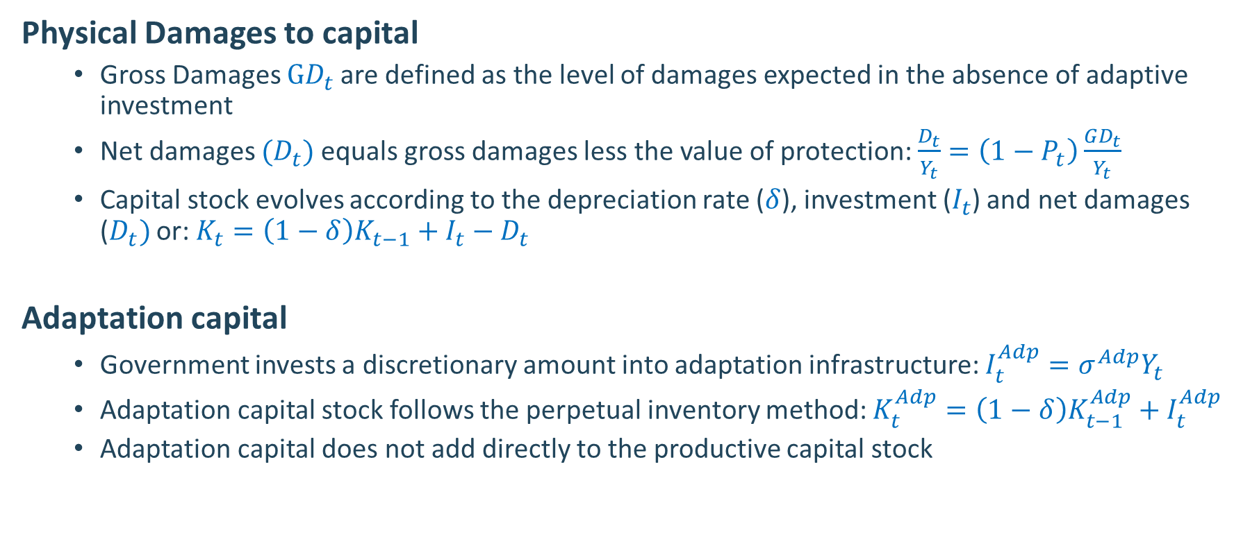
1. Adaptation: Equations
Physical Damages to capital
Gross Damages $GD_{t}$are defined as the level of damages expected in the absence of adaptive investment
Net damages ($D_{t})$ equals gross damages less the value of protection: $\frac{D_{t}}{Y_{t}}=\left(1−P_{t}\right)\frac{GD_{t}}{Y_{t}}$
Capital stock evolves according to the depreciation rate ($δ$), investment ($I_{t}$) and net damages ($D_{t})$ or: $K_{t}=\left(1−δ\right)K_{t−1}+I_{t}−D_{t}$
Adaptation capital
Government invests a discretionary amount into adaptation infrastructure: $I_{t}^{Adp}=σ^{Adp}Y_{t}$
Adaptation capital stock follows the perpetual inventory method: $K_{t}^{Adp}=\left(1−δ\right)K_{t−1}^{Adp}+I_{t}^{Adp}$
Adaptation capital does not add directly to the productive capital stock

Slide 9
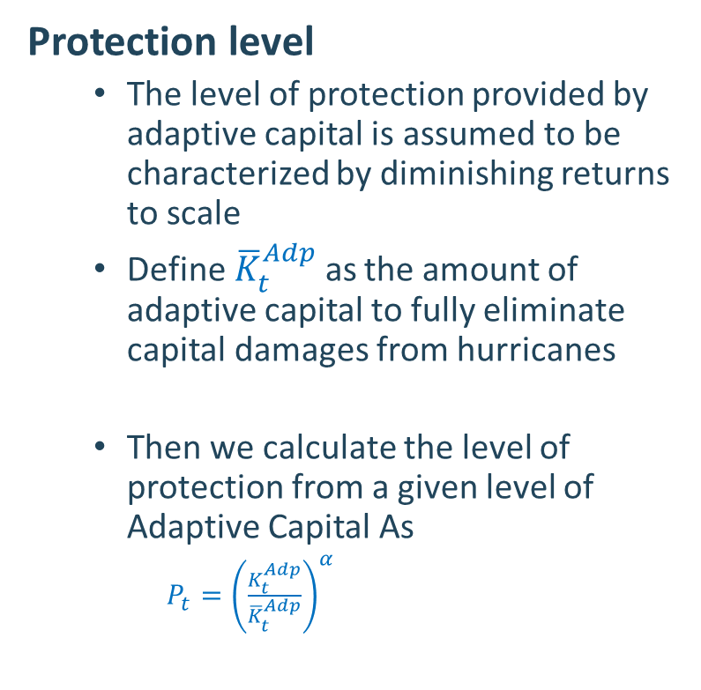

1. Adaptation: Equations
Protection level
The level of protection provided by adaptive capital is assumed to be characterized by diminishing returns to scale
Define${\overline{K}}_{t}^{Adp}$as the amount of adaptive capital to fully eliminate capital damages from hurricanes
Then we calculate the level of protection from a given level of Adaptive Capital As
$P_{t}={\left(\frac{K_{t}^{Adp}}{{\overline{K}}_{t}^{Adp}}\right)}^{α}$
$$α= .5$$
% of Maximum capital

Slide 10


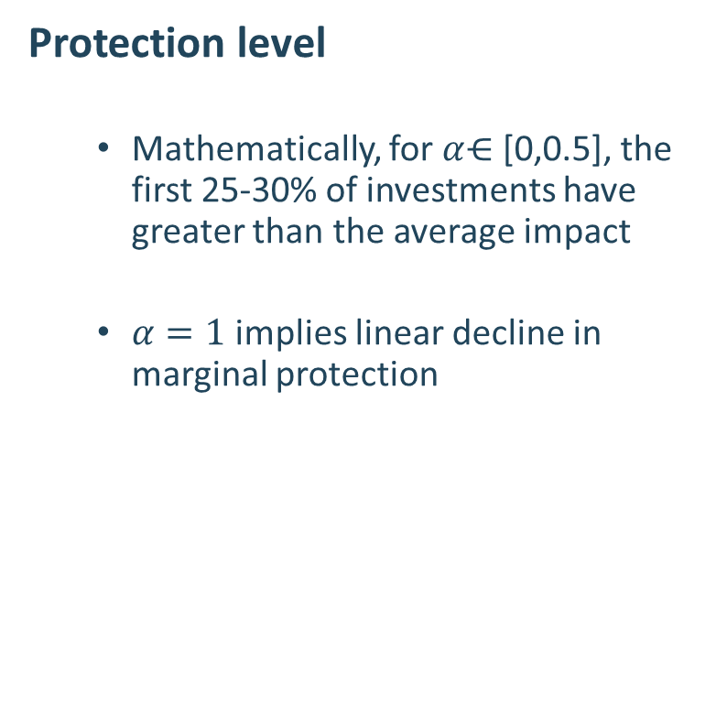



1. Adaptation: Equations
Protection level
Mathematically, for $α$⋲ [0,0.5], the first 25-30% of investments have greater than the average impact
$α=1$ implies linear decline in marginal protection
Marginal protection from adaptive capital
$α$ = 0.25
$α$ = 0.50
$$α= .5$$
$α$ = 0.75
$α$ = 1.00
% of Maximum capital

Slide 11

1. Adaptation in graphs
100% adaptation implies annual adaptation spending is equal to expected loss (1% of GDP per annum)
Trade off is between adaptation investment and productive investment
With low adapt. investment, large returns in terms of protection, and small costs in terms of forgone productive investment
$α=0.3$ in this simulation

Slide 12
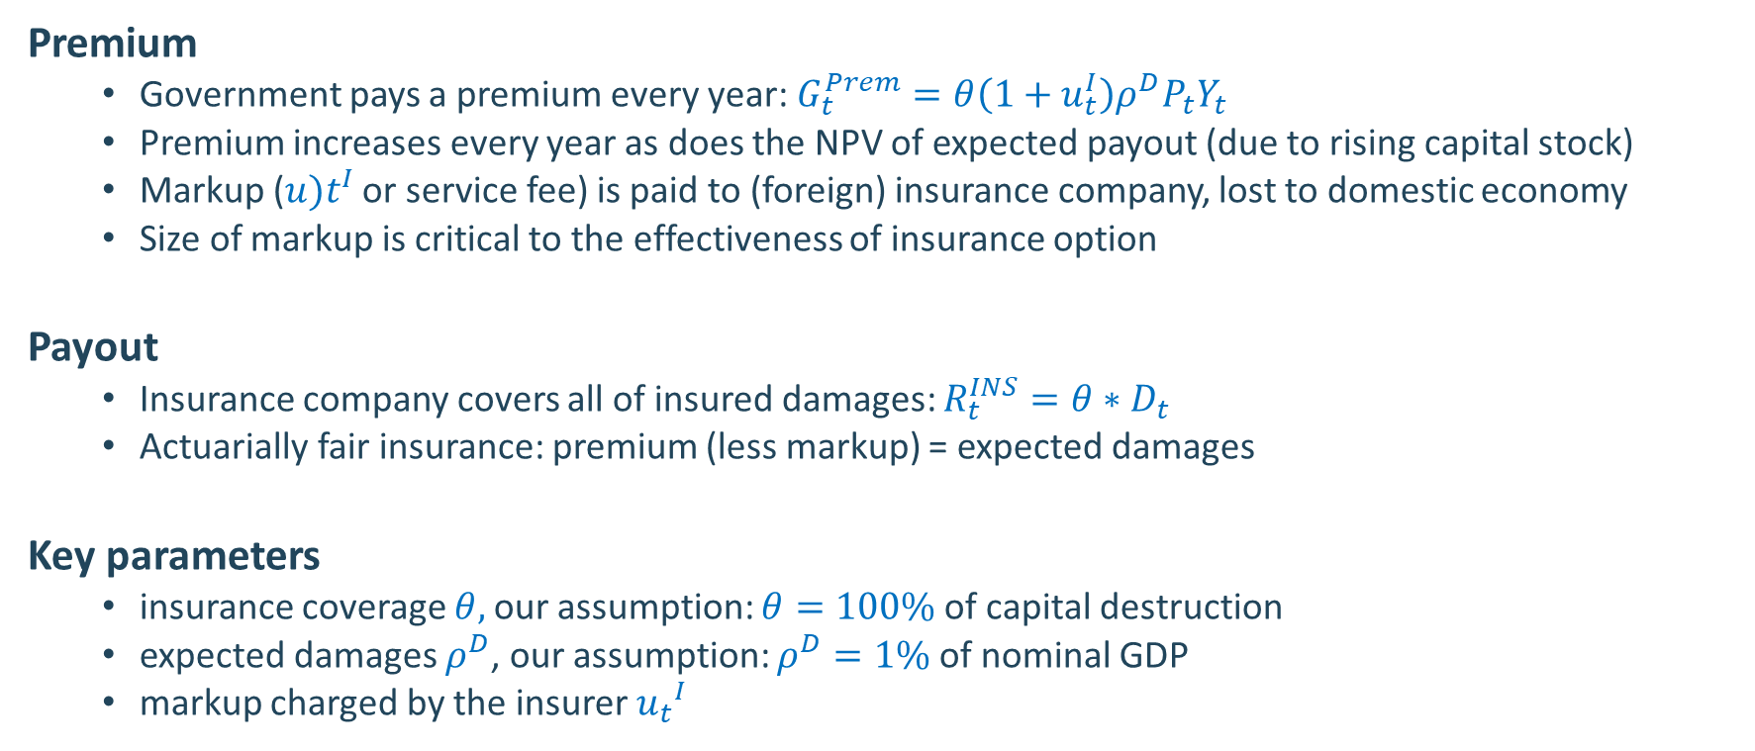
2. Insurance: Equations
Premium
Government pays a premium every year: $G_{t}^{Prem}=θ\left(1+u_{t}^{I}\right)ρ^{D}P_{t}Y_{t}$
Premium increases every year as does the NPV of expected payout (due to rising capital stock)
Markup (${u)t}^{I}$ or service fee) is paid to (foreign) insurance company, lost to domestic economy
Size of markup is critical to the effectiveness of insurance option
Payout
Insurance company covers all of insured damages: $R_{t}^{INS}=θ∗D_{t}$
Actuarially fair insurance: premium (less markup) = expected damages
Key parameters
insurance coverage $θ,$our assumption: $θ=100\%$ of capital destruction
expected damages $ρ^{D}$, our assumption: $ρ^{D}=1\%$ of nominal GDP
markup charged by the insurer ${u_{t}}^{I}$

Slide 13
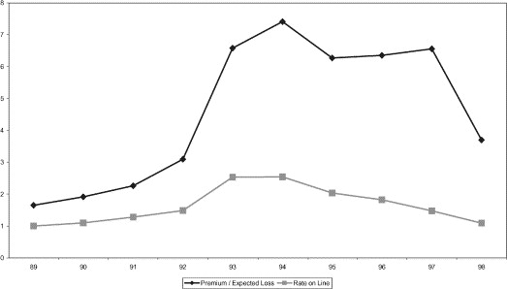
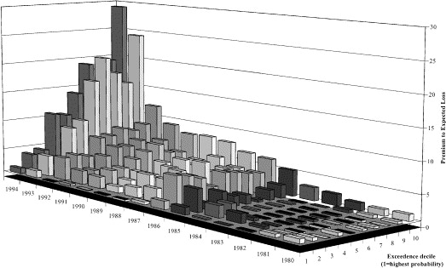
Evaluating markups is non-trivial
Insurance markup costs tend to rise with size of expected payouts and inversely with the regularity of the event (Froot, 2001)
Reinsurance costs
Reinsurance costs
Historical cost/
expected payout
Cost/
expected payout
Exceedance decile (1=highest probability)
expected payout
Markups can be as high as 70% over expected payout
Markups rise with reduced likelihood of events. Were as high as 170% in 1994

Slide 14
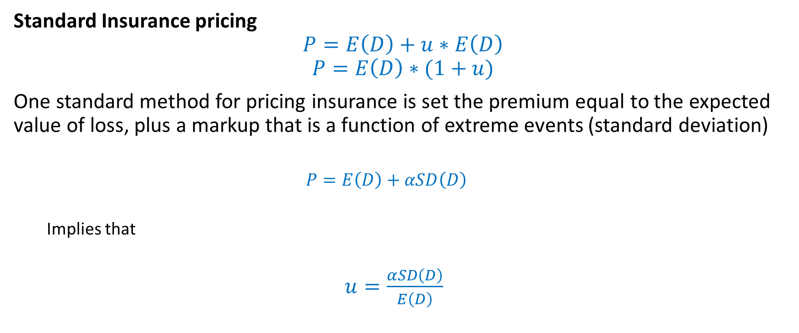
2. Insurance: Markup
Standard Insurance pricing
$$P=E\left(D\right)+u∗E\left(D\right)$$
$$P=E\left(D\right)∗(1+u)$$
One standard method for pricing insurance is set the premium equal to the expected value of loss, plus a markup that is a function of extreme events (standard deviation)
$$P=E\left(D\right)+αSD\left(D\right)$$
Implies that
$u=\frac{αSD\left(D\right)}{E\left(D\right)}$

Slide 15
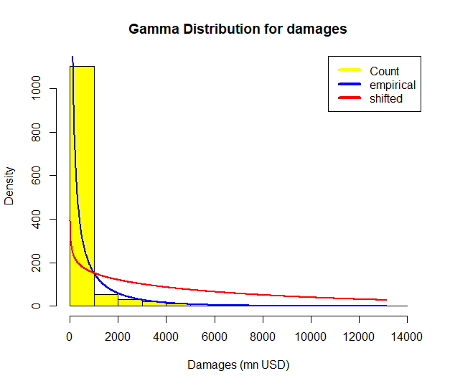
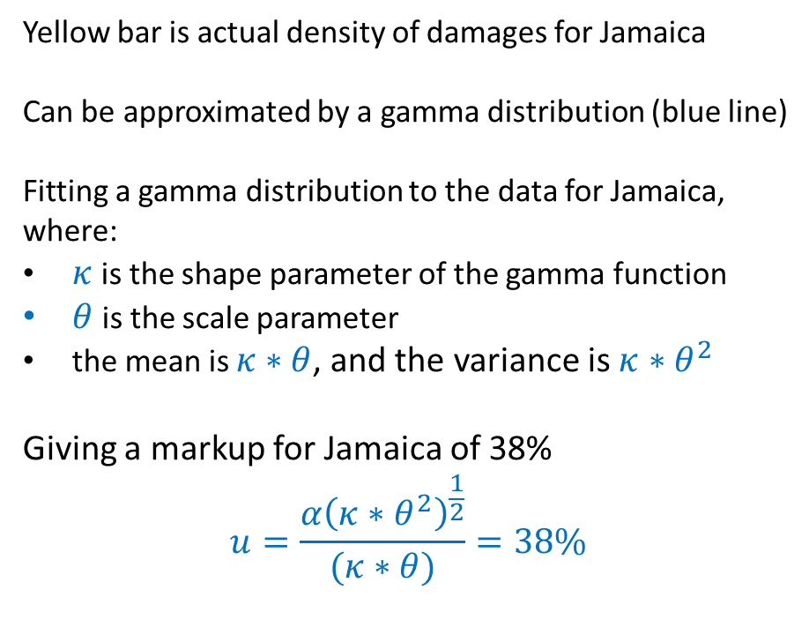
2. Insurance: Distribution of damages for Jamaica
Yellow bar is actual density of damages for Jamaica
Can be approximated by a gamma distribution (blue line)
Fitting a gamma distribution to the data for Jamaica,
where:
$κ$ is the shape parameter of the gamma function
$θ$is the scale parameter
the mean is $κ∗θ$, and the variance is $κ∗θ^{2}$
Giving a markup for Jamaica of 38%
$$u=\frac{α{\left(κ∗θ^{2}\right)}^{\frac{1}{2}}}{(κ∗θ)}=38\%$$

Slide 16
2. Insurance in graphs
Markups amplify costs with higher coverage rates
With 100% coverage low to medium markups can generate economic costs between 2% and 8% of GDP

Slide 17
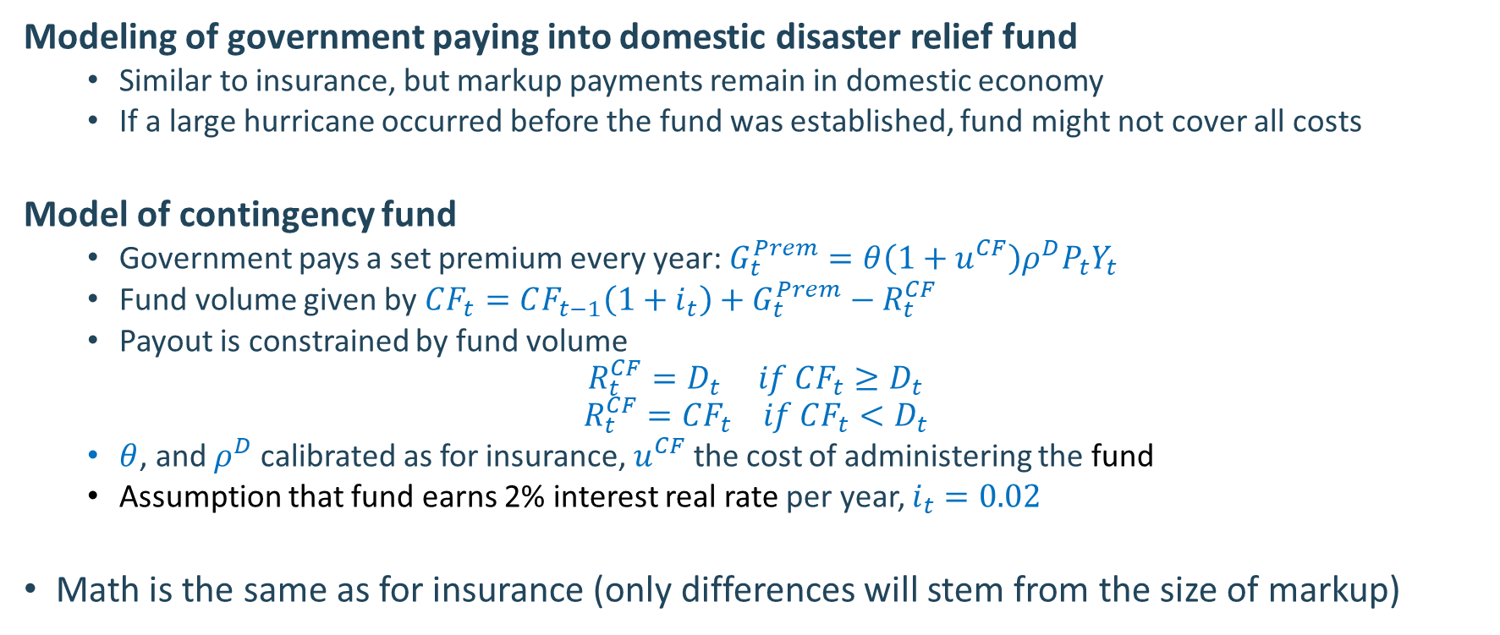
3. Contingency fund: Equations
Modeling of government paying into domestic disaster relief fund
Similar to insurance, but markup payments remain in domestic economy
If a large hurricane occurred before the fund was established, fund might not cover all costs
Model of contingency fund
Government pays a set premium every year: $G_{t}^{Prem}=θ\left(1+u^{CF}\right)ρ^{D}P_{t}Y_{t}$
Fund volume given by $CF_{t}=CF_{t−1}\left(1+i_{t}\right)+G_{t}^{Prem}−R_{t}^{CF}$
Payout is constrained by fund volume
$$R_{t}^{CF}=D_{t} if CF_{t}≥D_{t}$$
$$R_{t}^{CF}=CF_{t} if CF_{t}<D_{t}$$
$θ$, and $ρ^{D}$ calibrated as for insurance, $u^{CF}$ the cost of administering the fund
Assumption that fund earns 2% interest real rate per year, $i_{t}=0.02$
Math is the same as for insurance (only differences will stem from the size of markup)

Slide 18
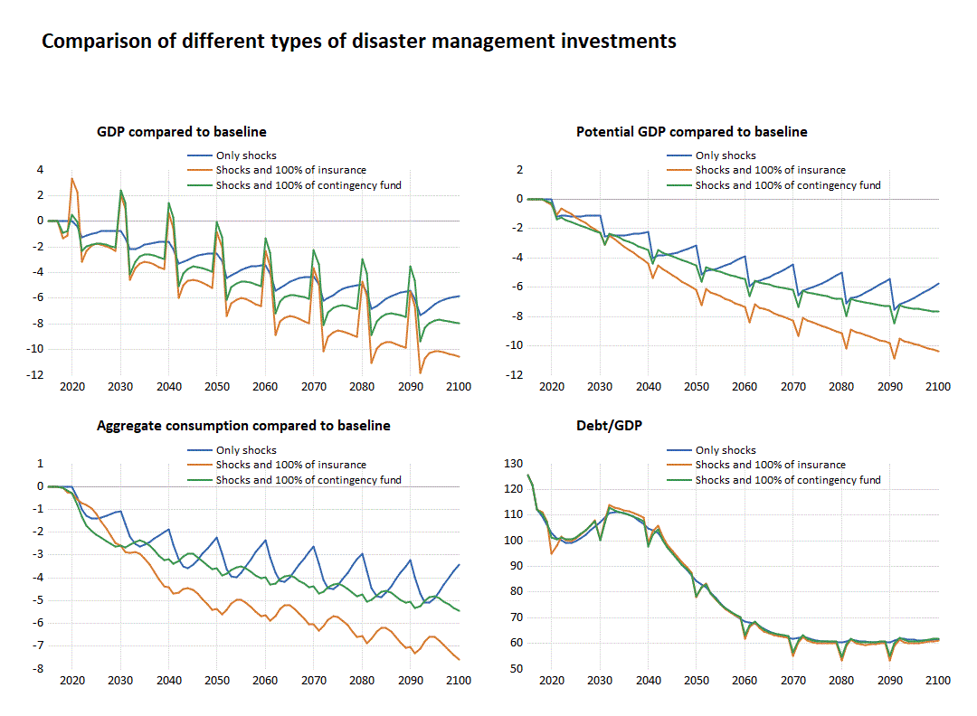
Insurance and contingency fund outcomes
Contingency and insurance funds yield similar outcomes. Main difference arise:
If events occur before the contingency fund is filled (only partial response possible)
If the markup or losses differ between the two instruments (ie. high insurance markup – or poor (even negative) returns from contingency fund investments

Slide 19
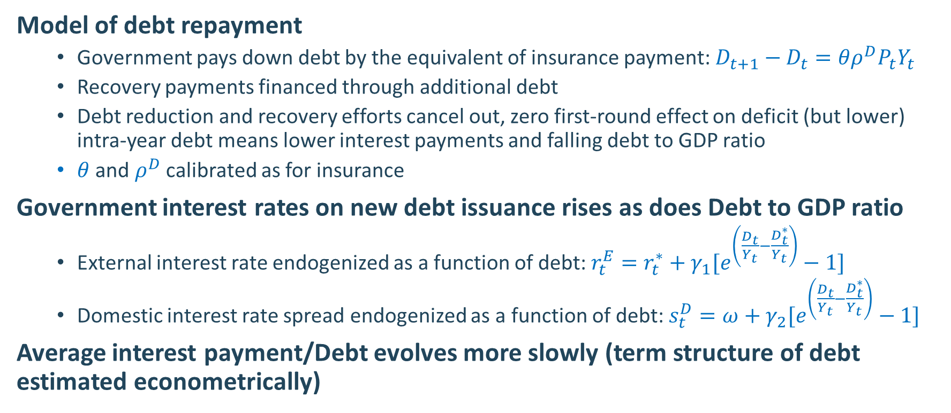
4. Debt repayment: Equations
Model of debt repayment
Government pays down debt by the equivalent of insurance payment: $D_{t+1}−D_{t}=θρ^{D}P_{t}Y_{t}$
Recovery payments financed through additional debt
Debt reduction and recovery efforts cancel out, zero first-round effect on deficit (but lower) intra-year debt means lower interest payments and falling debt to GDP ratio
$θ$ and $ρ^{D}$ calibrated as for insurance
Government interest rates on new debt issuance rises as does Debt to GDP ratio
External interest rate endogenized as a function of debt: $r_{t}^{E}=r_{t}^{∗}+{γ_{1}[e}^{\left(\frac{D_{t}}{Y_{t}}−\frac{D_{t}^{∗}}{Y_{t}}\right)}−1]$
Domestic interest rate spread endogenized as a function of debt: $s_{t}^{D}=ω+{γ_{2}[e}^{\left(\frac{D_{t}}{Y_{t}}−\frac{D_{t}^{∗}}{Y_{t}}\right)}−1]$
Average interest payment/Debt evolves more slowly (term structure of debt estimated econometrically)

Slide 20
4. Debt reduction in graphs
Show debt reduction yields gains via
Debt reduction strategy delayed with higher yields, but once target is reached creates even more fiscal space
freeing up fiscal space for government investment and therefore higher potential output
Lower interest rate and therefore higher private-sector investment

Slide 21
Comparison of the policy options

Slide 22
Comparison of risk management (100% coverage)
At 100% none of the strategies does better than do nothing scenario
At high levels of investment, insurance costs rise too much
Insurance scenario is worst
Debt repayment is better than other options

Slide 23
Impacts are reduced if government cuts both consumption and investment
Same shock as before
But because government investment is not cut as much
Long-term GDO impacts are less severe, though household effects larger

Slide 24
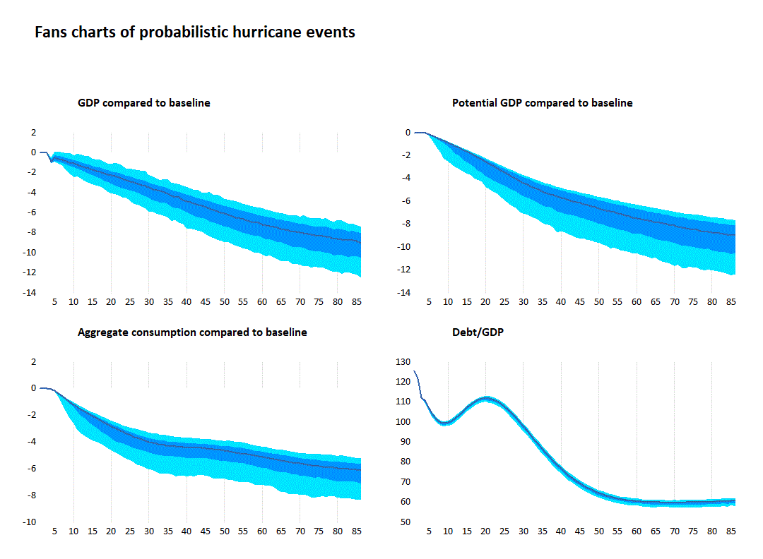
Probabilistic analysis: Contingency fund
Model was also run to generate drawing from the underlying distribution of hurricanes to generate stochastic outcomes.
Results here for contingency fund show a wide asymmetric range of possible outcomes
Distribution is wide (ranging from -6 to -12% of GDP
Is skewed to lower end with absolute value of median result

Slide 25
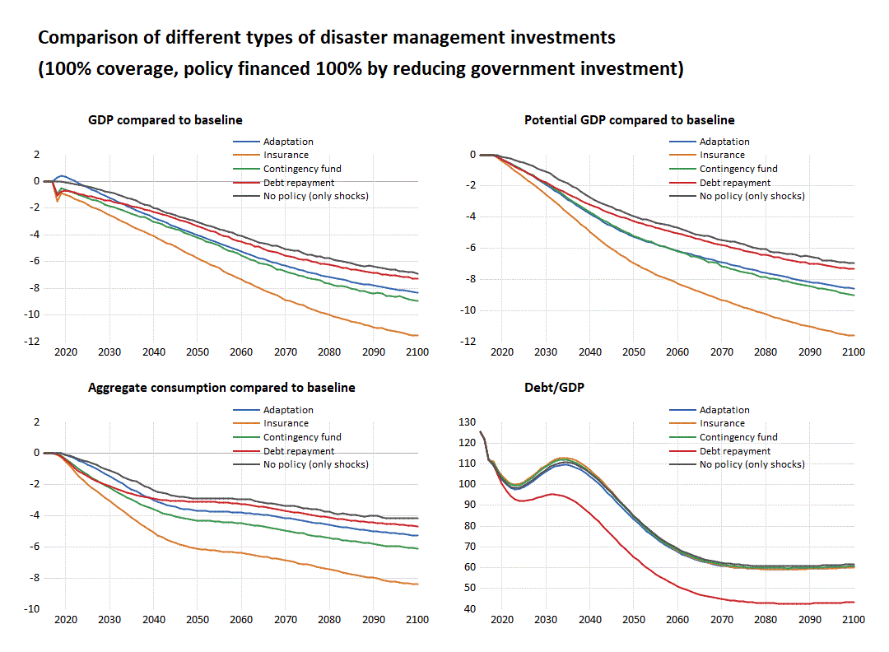
Comparison of risk management (stochastic)
Median results from stochastic simulations using random draws from GSURR probability
If budgetary rigidities do no allow a reduction in recurrent spending and the government is forced to finance different options through a reduction of investment, all instruments are deteriorating welfare
Debt repayment, establishing a contingency fund and invest into physical adaptation capital are statistical equivalent.
Insurance does not provide long-term benefits.
The budget constraint (debt rule) forces the government to finance resilience through a reduction of public spending

Slide 26
Optimal combination of instruments
Welfare computation over both (i) frequency and (ii) size of shock – all 100% coverage
If shocks occur at a 20 year frequency, then for smaller shocks create fiscal space, otherwise use adaptation
If shocks occur at a 10 year frequency, then for smaller shocks create fiscal space, otherwise use combination of adaptation and insurance
If shocks occur at a yearly frequency, then for all shocks create fiscal space, otherwise use combination of fiscal space and insurance

Slide 27
Optimal combination of instruments
Policy experiment 1: For different size of shocks (one-time event), which policy option is best?
For smaller GDP shocks, creating fiscal space is least harmful for GDP
For big GDP shocks, adaptation beats other policy responses
For all shocks, adaptation beats other policy responses in terms of potential GDP

Slide 28
Summary

Slide 29
Choosing among policy options
Adaptation
Adaptation is the dominant policy for a sub-set of damages
Should be undertaken for all those cases where the marginal damage reduction is less than the annual expected damage from hurricane (circa 25% of total expected costs)
Debt repayment
Efficacy of debt repayment depends on level of ex ante level of debt and interest rate sensitivity to debt levels
For a country like Jamaica it is a dominant strategy (along with adaptation) in the short run
Risk is that markets may not be willing to provide aid rapidly following the offset of a hurricane
Commercial insurance and Contingency fund
Principle benefit of insurance is rapid payout and possibility to get projects running quickly
Main difference between tools lies in insurance markup vs cost of managing fund (which would include risk of poor investments and weak or even negative fund growth)
Historically markups can be dissuasively large, but this will be an empirical issue determined on a country-by-country basis
Depending on nature of assets that assets hold a contingency fund may be insufficiently liquid or not yet large enough to provide payment
Foregone productive use of funds (for public investment or consumption) is the main opportunity cost for all policies options.

Slide 30
Caveats
All simulation results are sensitive to parameters
Significant areas of uncertainty include (efficiency of $ spent on adaptation).
Degree of diminishing rate of return of adaptive spending (model results fairly robust for alpha between 1 and .5
Markup cost of insurance.
Interest rate sensitivity to debt levels
Size and frequency of events. More frequent events of similar magnitude are associated with lower markups and favor insurance options
Modelling only addressed capital damage
No attempt to evaluate productivity impacts, distinguish between productivity effects from the destruction of inframarginal vs marginal capital projects

Slide 31
Appendix 1: Robustness

Slide 32
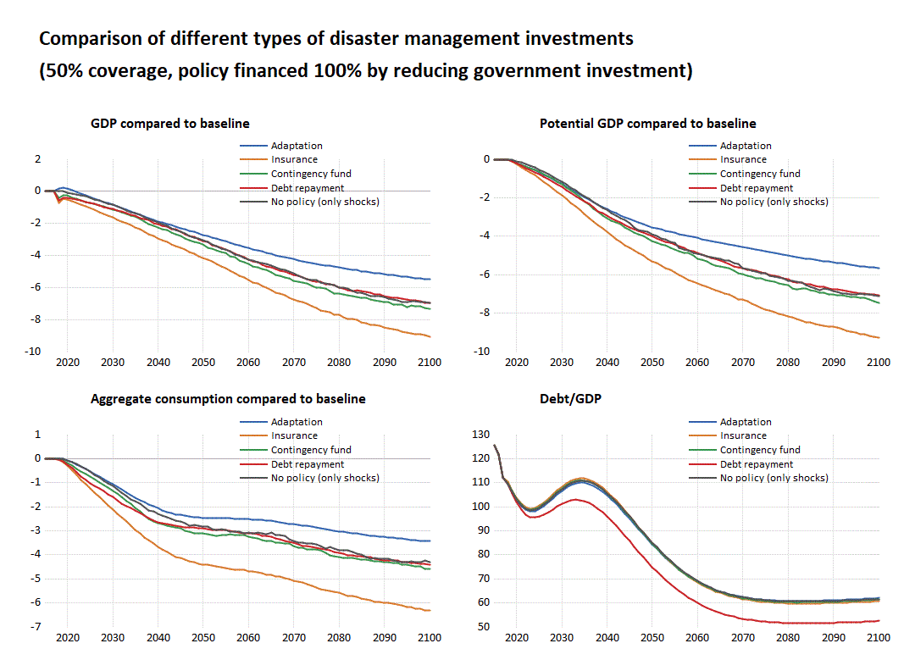
Robustness check: coverage
Scenario: 50% coverage
Adaptation is the only instrument that improves welfare
Establishing a contingency fund and debt repayment perform similar to ex-post solutions.
Insurance does not provide long-term benefits.

Slide 33
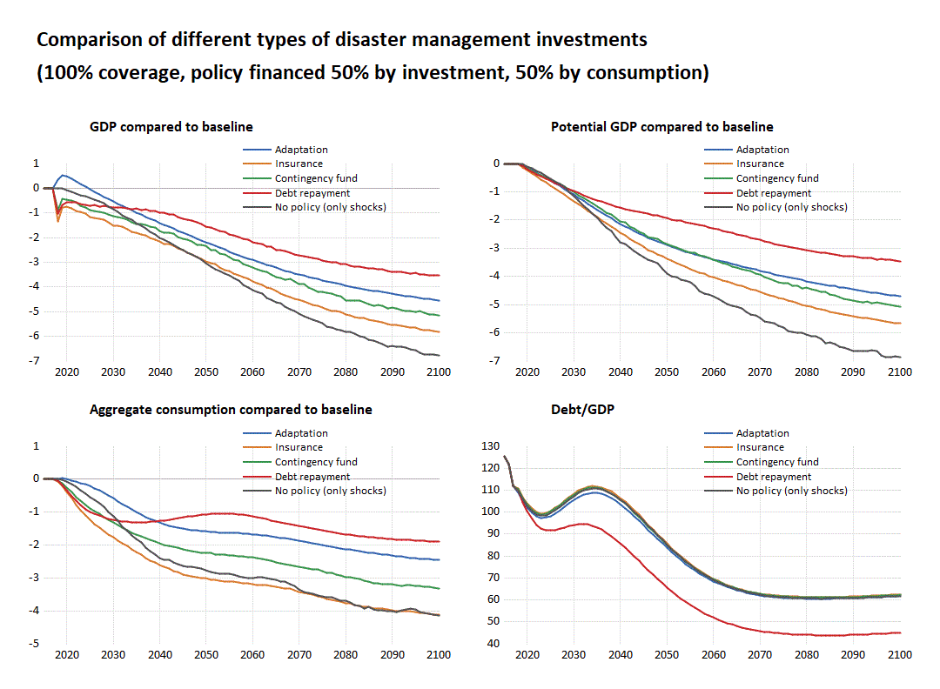
Robustness check: financing source
Scenario: reduction of public spending (50%) and investment (50%)
Adaptation outperforms other instruments in the short and (for most) in the medium term
Benefits of accelerated debt repayments surpasses adaptation in the long run because of the diminishing return of adaptation investment as well as large impact on debt service/fiscal space of a debt repayment strategy
Contingency fund outperforms insurance because of the large mark up. However, insurance is a better option than “no resilience” strategy.

Slide 34
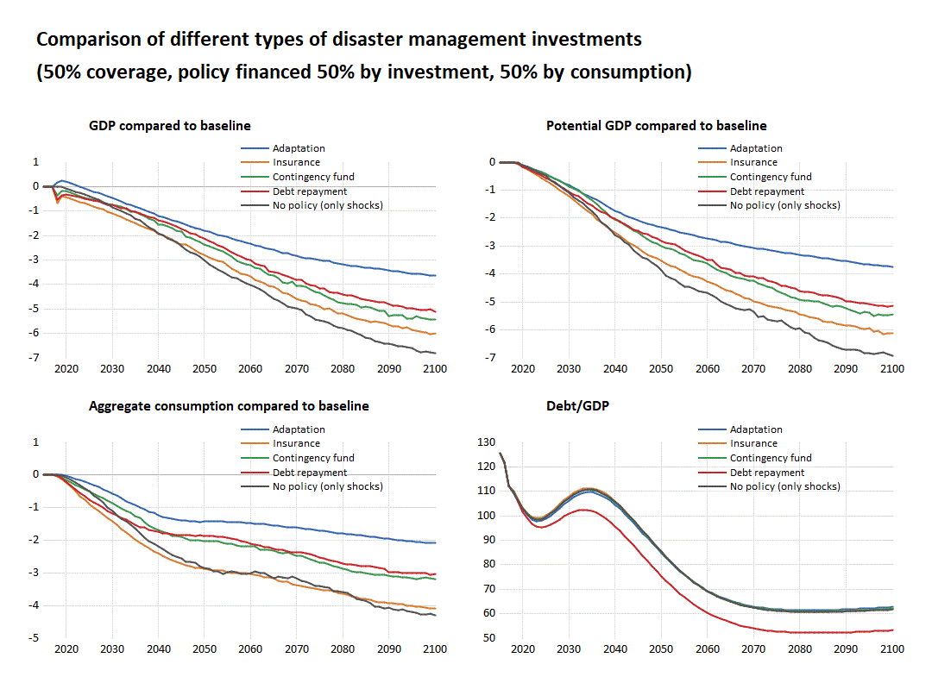
Robustness check: coverage and financing
Scenario: combination of two previous scenarios
Adaptation outperforms, while establishing a contingency fund and debt repayment are statistical equivalent
Insurance does not provide long-term benefits

Slide 35
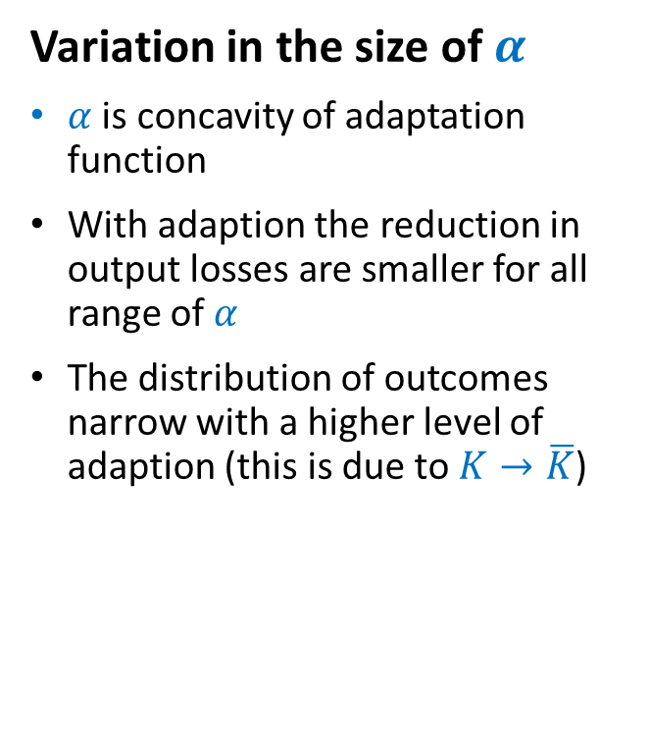
Robustness check: concavity
Variation in the size of $α$
$α$ is concavity of adaptation function
With adaption the reduction in output losses are smaller for all range of $α$
The distribution of outcomes narrow with a higher level of adaption (this is due to $K→\overline{K}$)

Slide 36
2A: 50% of investment/coverage that is financed by 50% reduction in public investment and 50% reduction in public consumption (e.g. 50% of initial fiscal cost of 1A)
Median results from stochastic simulations using random draws from GSURR probability
The limited fiscal space forces the government to only invest half of what is needed to finance resilience through a reduction of pubic spending (in this case investment and consumption)
Adaptation outperforms, while establishing a contingency fund and debt repayment are statistical equivalent
Insurance does not provide long-term benefits

Slide 37
2B: 50% of investment/coverage that is financed by 100% reduction in public investment
Median results from stochastic simulations using random draws from GSURR probability
The combination of limited fiscal space and budgetary rigidities force the government to only invest half of what is needed for resilience and financed only through a reduction of investment
Adaptation is the only instrument that improves welfare
Establishing a contingency fund and debt repayment are statistically equivalent and similar to ex-post solutions.
Insurance does not provide long-term benefits.

Slide 38
Appendix 2: Insurance markups

Slide 39
Markups can be large for big events
Insurance markup costs tend to rise with size of expected payouts and inversely with the regulatory of the event (Froot, 2001)
Reinsurance costs
Reinsurance costs
Historical cost/
expected payout
Cost/
expected payout
Exceedance decile (1=highest probability)
expected payout
Markups can be as high as 70% over expected payout
Markups rise with reduced likelihood of events. Were as high as 170% in 1994

Slide 40
Appendix 3: Probabilistic analysis

Slide 41
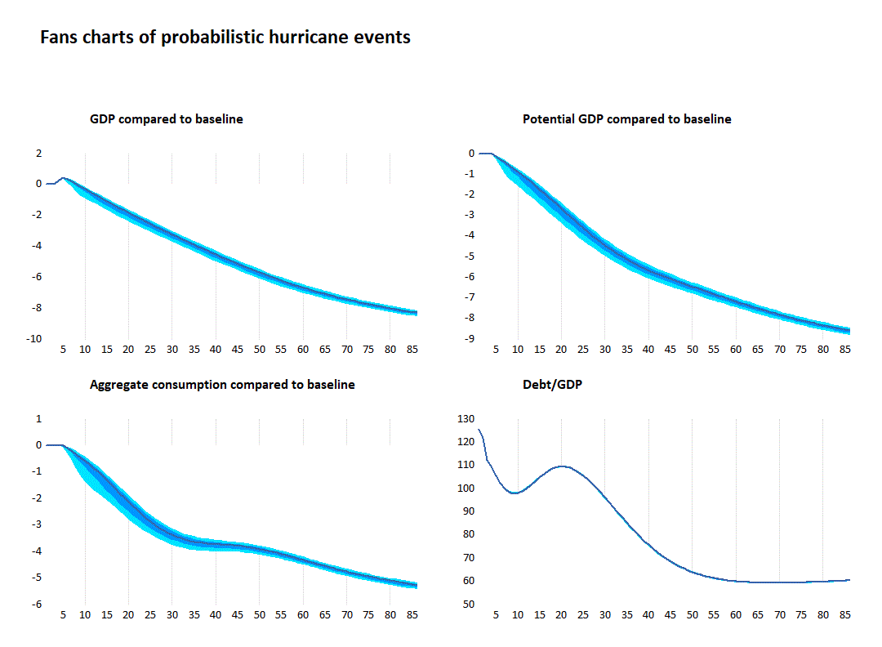
Probabilistic analysis: Adaptation
Probabilistic shocks
Dark blue line: median
Dark blue area: between 25th and 75th percentile
Light blue area: between 10th and 90th percentile
Scenario: Adaptation investment
Variance of results is narrow because adaptation investment reduces capital losses from climate events
Fiscal rule ensures that debt levels converge to 60% of GDP in long run

Slide 42
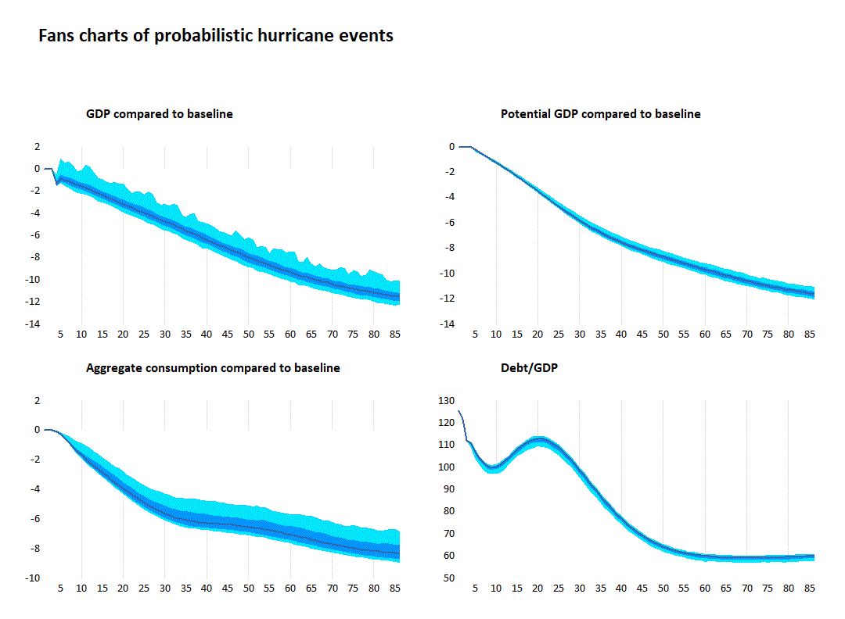
Probabilistic analysis: Insurance
Larger uncertainty around the GDP impacts in the long-run
Fiscal rule means government is cutting investment and spending by amount of premiums (until 60% debt level arrived at)
Afterwards impact on current spending and potential output is reduced (see inflection point in potential output / GDP around year 50)

Slide 43
Robustness check: Payout use
Scenario: reducing investment with payout to government consumption
Larger uncertainty around the GDP impacts in the long-run
Increased spending of payouts, slows arrival at 60% debt level
Payouts contribute to increased volatility of GDP
Because spending is on consumption only, potential output is broadly unchanged from saving scenario

Slide 44
Robustness check: financing source
Scenario: reducing public consumption with payout to investment
Payout focused on replacing damaged capital stock
Spending pattern follows incidence of shock, potential output and GDP higher than in previous three scenarios because of investment.
Higher potential GDP means higher revenues and quicker achievement of 60% debt to GDP objective

